Slide 1
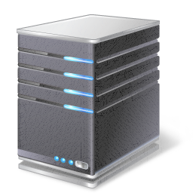

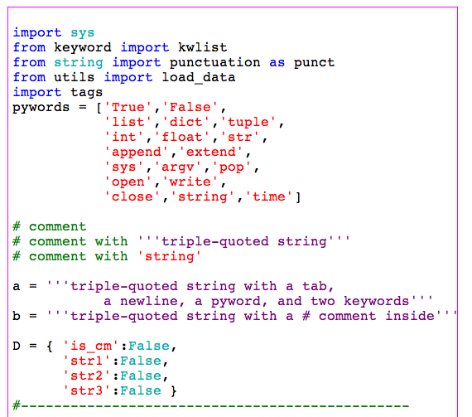


Data Science Division: Git & GitHub 101
October 9th, 2020
Sophia Doerr

Slide 2

Code Reproducibility
What is it and why does it matter?
Ability to rerun analysis and obtain the same outputs given the same inputs
Reproducibility facilitates:
Building upon existing analyses
Modification and rearrangement of code
Distribution of analyses
Transition to production tools
Verifiability
MARMC
Output
Analysis
Input Data
NWRMC
SERMC
SWRMC

Slide 3
Aspects of Code Reproducibility
Clear Project/Analysis Structure
Standard organizational structure of analytic components (Preprocessing, EDA, etc.)
Version Control
Controlled tracking of changes to code over time within an organized system
Coding Standards
Software best practices such as modular, clean coding
Documentation
Comments within code, higher level descriptions of code pieces
Virtual Environments
Ability to reproduce and distribute package versions required to run code
Code/Unit Testing
Small modular tests of pieces of code combined with larger tests after modifications
MARMC
Our focus today

Slide 4
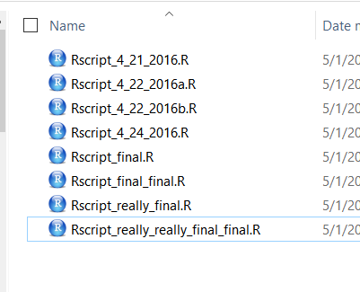
Motivation
Collaboration
DSD “Surge Week”
Multiple ‘final’ versions of code
Revert back to older versions
Version Control: documented and controlled history of changes
Easily share analysis with others for smoother collaboration

Slide 5

What is Git?
Most widely used version control system worldwide:
Open source
Actively maintained
Developed in 2005 by Linus Torvalds
DVCS: Distributed Version Control System
Personal working copy of code
Git repo version history: contains what has been committed, changed, deleted, added, or ignored
Order of operations matters!
Remote Repo
MARMC
NWRMC
SERMC
SWRMC
Local computer
Individual code

Slide 6
Git vs. GitHub
Git: Version control system behind all interactions with a repo
Github.com: Common host of git, connects git software to a centralized online repository
Allows public and private repos
Enterprise solution: GitHub Enterprise
CNA Github: https://github.cna.org
Login using CNA credentials (username and password)
Email AskHelp to get set up
Remote Repo
MARMC
NWRMC
SERMC
SWRMC
Local computer
Individual code

Slide 7
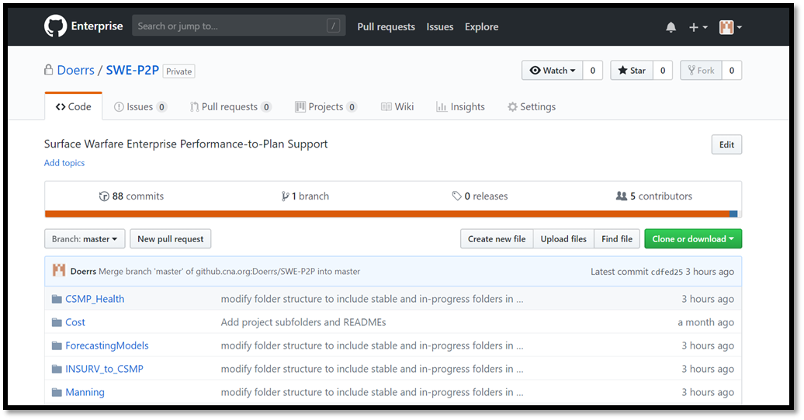
Data Science Division GitHub Standardization
One Repository for each Data Science Project:
Contains folder for each analysis
Common location for tracking changes
Easy sharing of analysis
Easy to revert to previous versions
Easy to track multiple versions (e.g. “what if” analyses)
Example: SWE P2P
MARMC
NWRMC
SERMC
SWRMC
Folder Structure

Slide 8
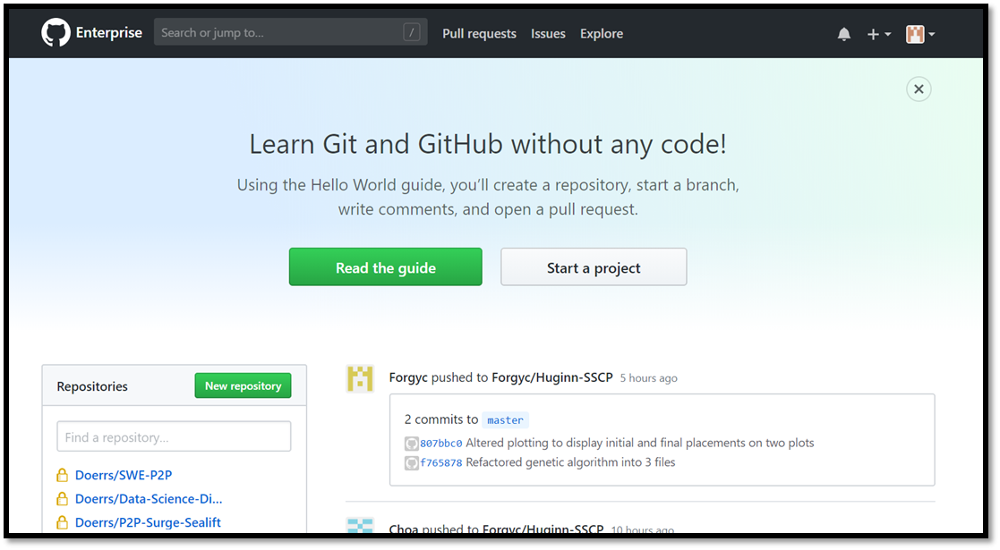
Getting Started
Create your project repo:
Navigate to https://github.cna.org
Login with CNA credentials
Click “New repository”
Click here
MARMC
NWRMC
SERMC
SWRMC

Slide 9
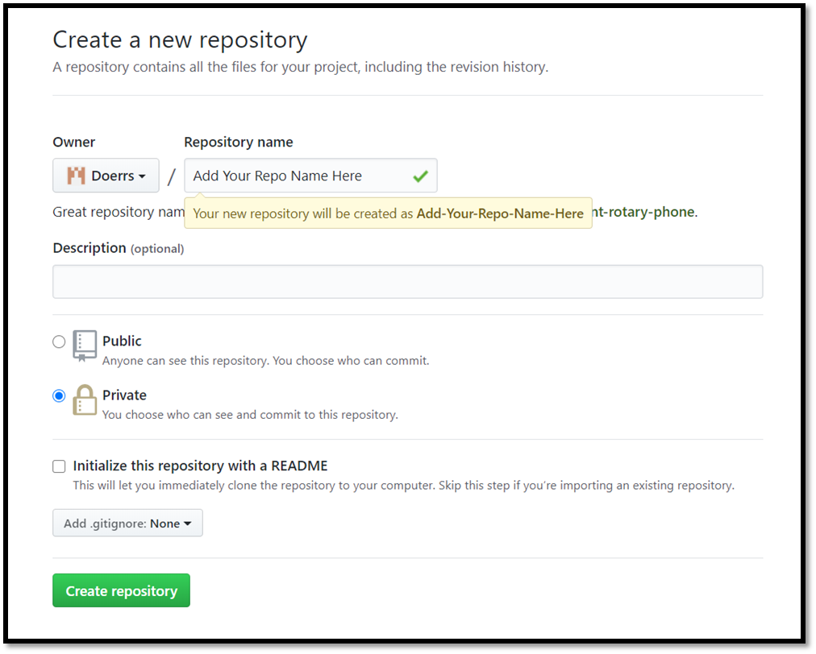
Getting Started
Create your project repo:
Navigate to https://github.cna.org
Login with CNA credentials
Click “New repository”
Fill out desired project name and additional information
Choose “Private” repo style
Click “Initialize this repo with README”
Click “Create repository”!
MARMC
NWRMC
SERMC
SWRMC

Slide 10
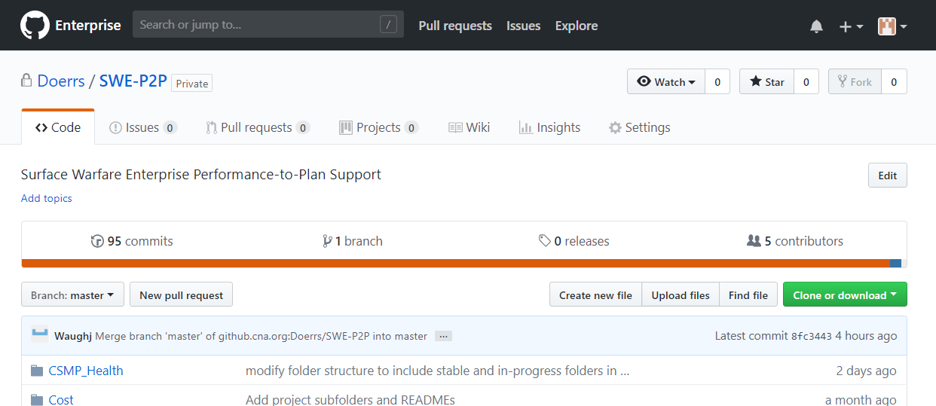
Adding Collaborators to Private Repo
Invite Teammates to Repo
Navigate to Repo Home page
Click on “Settings”
MARMC

Slide 11
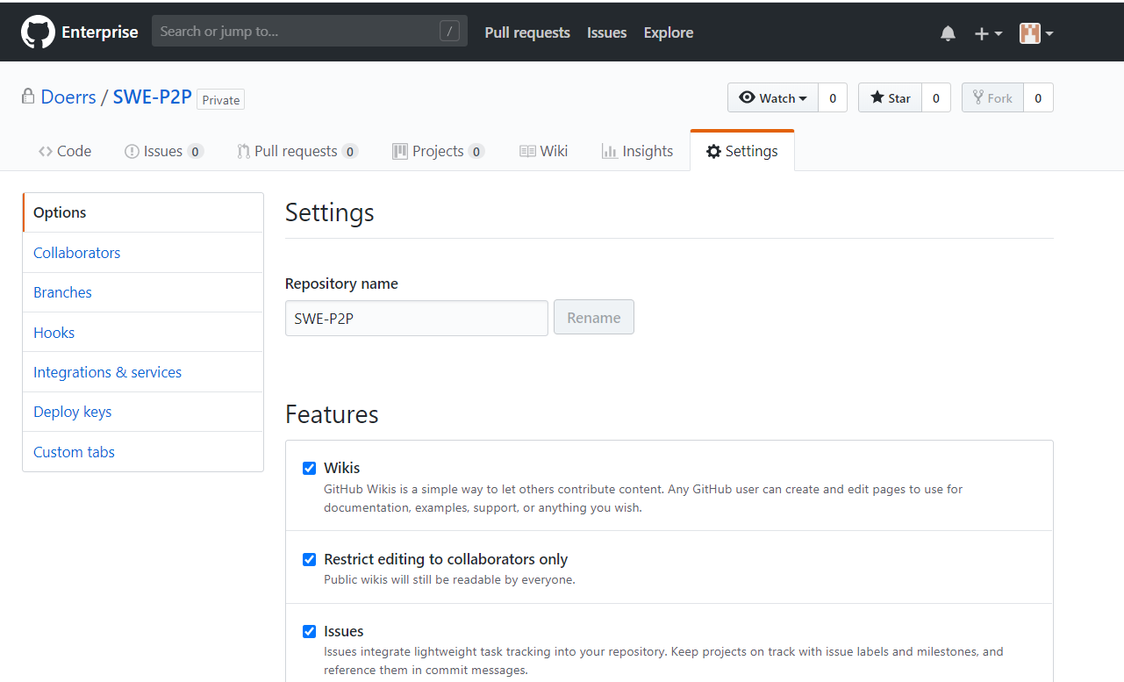
Adding Collaborators to Private Repo
Invite Teammates to Repo
Navigate to Repo Home page
Click on “Settings”
Click on “Collaborators”
MARMC

Slide 12
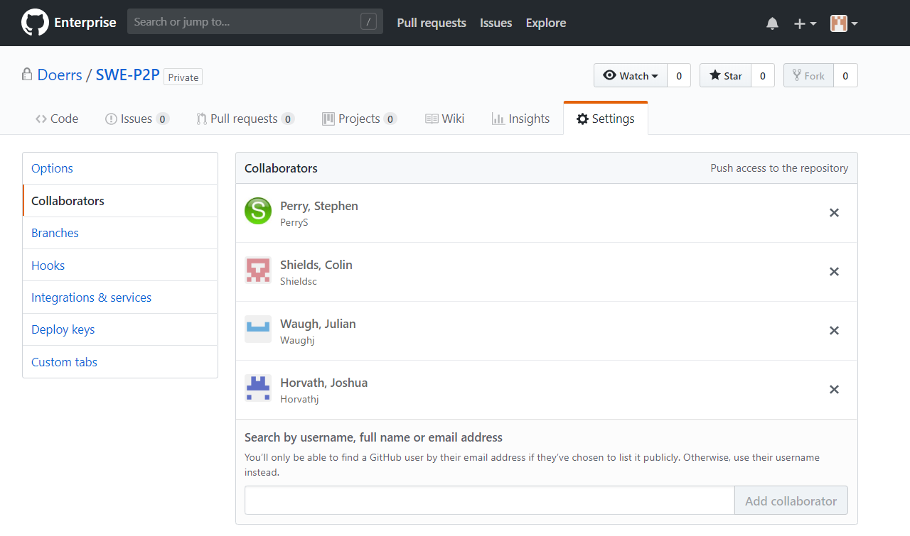
Adding Collaborators to Private Repo
Invite Teammates to Repo
Navigate to Repo Home page
Click on “Settings”
Click on “Collaborators”
Add teammate usernames into box and click “Add collaborator”
MARMC

Slide 13
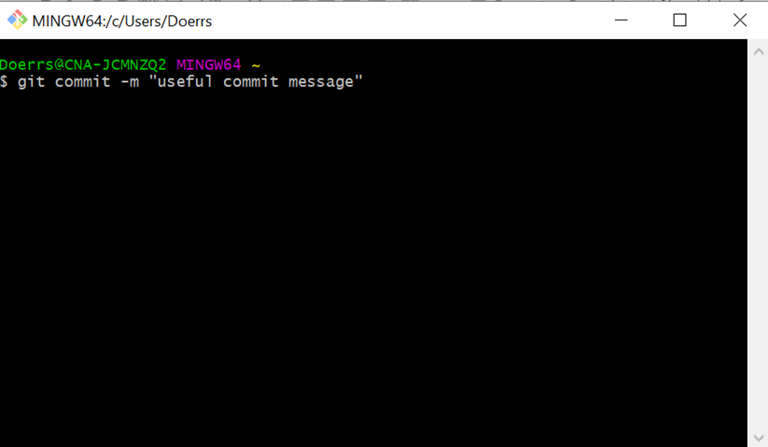

Git Bash
To interact with git from local machine
Git Bash: Windows shell with git installed
Github for Desktop has easy UI interface, but prevents full understanding of git
Install from: https://gitforwindows.org/
Download link
Click on ‘exe’ and run
Admin access not required to install
Already installed and set up on Lovelace
MARMC
NWRMC
SERMC
SWRMC

Slide 14
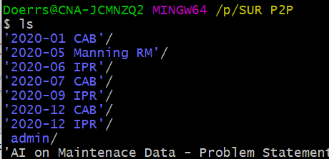
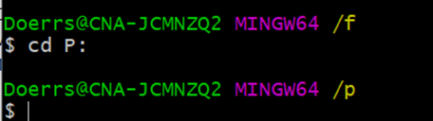
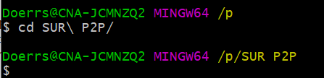

Bash Commands
ls Example
Useful bash commands for Git Bash
ls + Enter
Shows files and folders in CWD
cd “filepath” + Enter
Replace “filepath” with filepath to move into
For folder names with spaces, use backslash
mkdir “new directory name” + Enter
Create new folder in CWD
Lists files and folders in SUR P2P folder
MARMC
cd Examples
Changes CWD to P drive
Changes CWD to SUR P2P on P drive
NWRMC
SERMC
SWRMC
mkdir Example
Makes a new folder in SUR P2P called new_folder

Slide 15
Bash Commands
Additional bash commands:
touch “filename” + Enter
Creates empty file named “filename” in CWD
mv “filename” “folder/” + Enter
Moves file named “filename” to the folder “folder”
cp “filename” “folder/” + Enter
Copies file named “filename” to the folder “folder”
mv and cp will overwrite files of the same name in destination
cat “filename” + Enter
Lists out the content of a file named “filename” in bash window
Visit this source for additional help with bash: https://www.pcsuggest.com/basic-linux-commands/
MARMC
NWRMC
SERMC
SWRMC

Slide 16
SSH for Account Authentication
Must authenticate your Git Bash client with Github.cna.org:
SSH instead of https (faster and more robust encryption)
Key Generation Instructions:
Open GitBash
Type in: ssh-keygen –t ed25519 –C your_email@cna.org + Enter
Press enter to accept the default file location for your key
Enter an SSH key passphrase and re enter to confirm
Now to add SSH key to ssh-agent:
Type in: eval $(ssh-agent –s) + Enter
Type in: ssh-add ~/.ssh/id_ed25519 + Enter
MARMC
NWRMC
SERMC
SWRMC

Slide 17
SSH for Account Authentication
Must authenticate your Git Bash client with Github.cna.org:
SSH encryption instead of https (faster and more robust encryption)
Add SSH key to Github account
Again in Git Bash, type in: clip < ~/.ssh/id_ed25519.pub
Copies the contents of the key to clipboard to paste into github
Log into Github.cna.org
Go to settings > SSH and GPG keys
Click New SSH key
Paste into “Key” text box
Add “Title” (name of laptop or computer you’re authenticating from)
Click “Add SSH key”
MARMC
NWRMC
SERMC
SWRMC

Slide 18
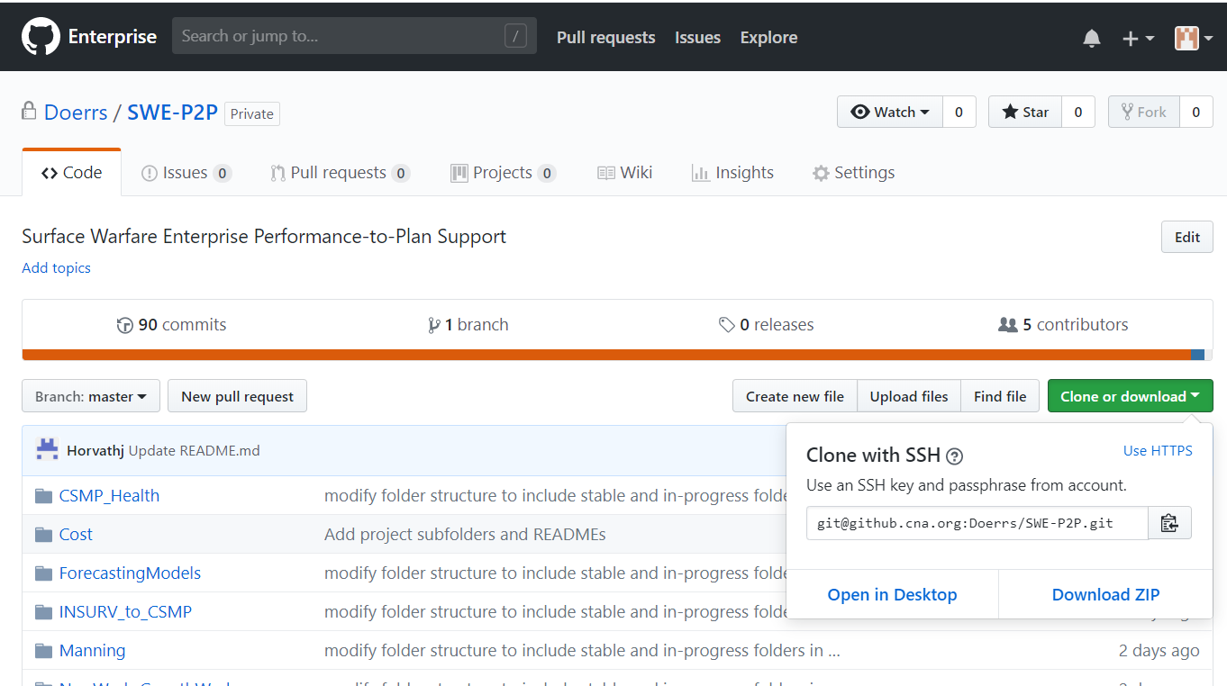
Cloning Repo to Local Machine
Must authenticate your Git Bash client with Github.cna.org:
Pick a place within your PRIVATE folder to store your repo for the project
Each individual needs their own copy in a place only accessible by them
The remote git repo will allow sharing code with team
To clone:
Go to repo home page
Click “Clone or download”
Switch to “Use SSH”
Copy link
MARMC
NWRMC
SERMC
SWRMC

Slide 19
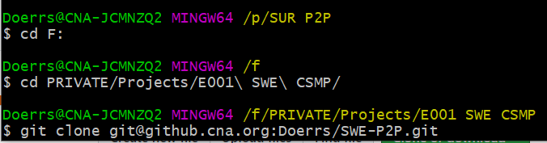
Cloning Repo to Local Machine
Must authenticate your Git Bash client with Github.cna.org:
To clone (part II):
Open Git Bash
Navigate to private folder where you want to put the repo using “cd”
Type in: git clone “paste link from repo” + Enter
To paste into Git Bash, right click where you want to paste and select paste from drop-down menu
MARMC
NWRMC
SERMC
SWRMC
Navigate to folder
Git clone repo

Slide 20

Project Folder Structure
Decide how to split up lines of analysis within git repo
Create folder for each analysis:
Open Git Bash
Navigate to git repo
mkdir “analysis_1”
cd “analysis_1”
mkdir stable
mkdir in-progress
MARMC
Project Repository Folder Structure
analysis_1
NWRMC
stable
SERMC
SWRMC
in-progress
README.md
Should see branch in parenthesis when in repo
analysis_2
stable
in-progress
README.md
README.md
Note: name your analysis folders whatever is appropriate for type of analysis (manning, workload, etc.)

Slide 21
Project Folder Structure
Decide how to split up lines of analysis within git repo
Stable folders: Use for analysis that’s been converted to modular commented code (i.e. .py function files)
In-progress folders: Use for analysis that’s in development (i.e. jupyter notebook files)
Not all code needs to end up in the stable folder, but work towards the conversion
MARMC
Project Repository Folder Structure
Analysis_1
NWRMC
stable
SERMC
SWRMC
in-progress
README.md
Analysis_2
stable
in-progress
README.md
README.md
Notes:
Tends to be better practice to only create branches to work on new functionality; not just have an open branch per person. Consolidation can get tricky.
Should setup shared data directory where all code points to…
Should also ensure, in code, if local directory is needed, create it (or check for it then create it if necessary)

Slide 22
README Files
README files are found at top level of repo and inside each analysis folder
Markdown is used to create documentation
Document higher level repo structure and lower level analysis structure
Resource: https://guides.github.com/features/mastering-markdown/
Basics:
Title headers are created at three levels
# for largest, ## for second largest, and ### for smallest header
Text not preceded by “#” will become body text
Asterisks to create bulleted lists (* list item 1)
Inline code: ` code text `
MARMC
NWRMC
SERMC
SWRMC

Slide 23
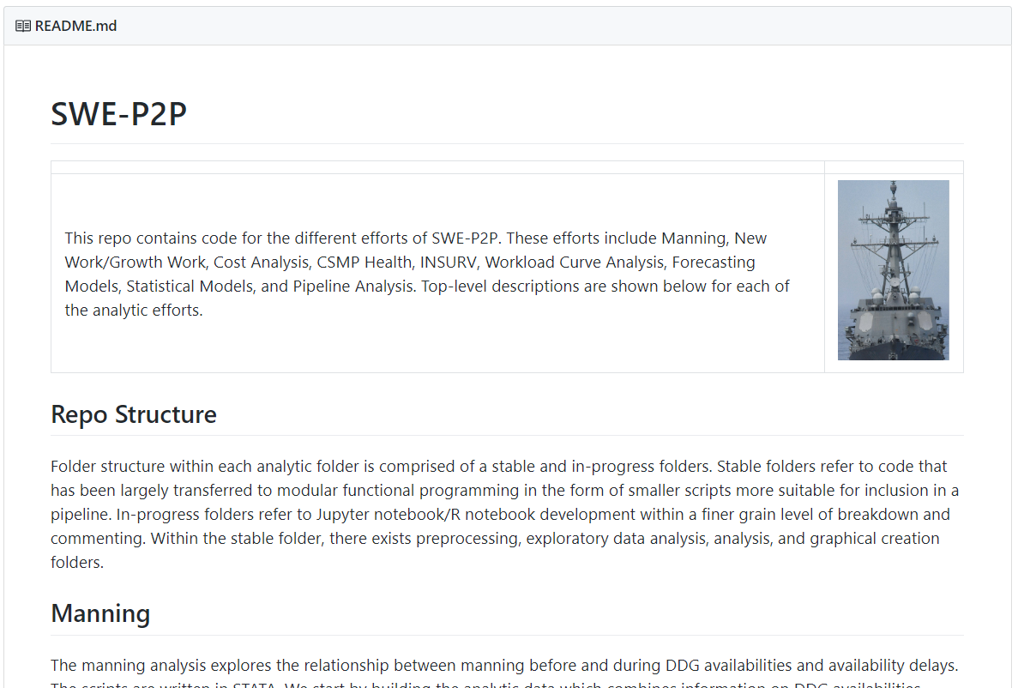
README Files
README files are found at top level of repo and inside each analysis folder
SWE-P2P README example:
MARMC
NWRMC
SERMC
SWRMC

Slide 24
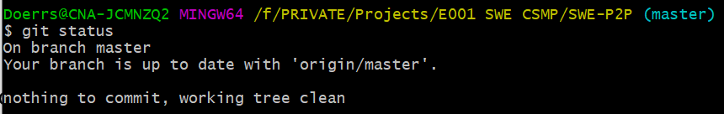
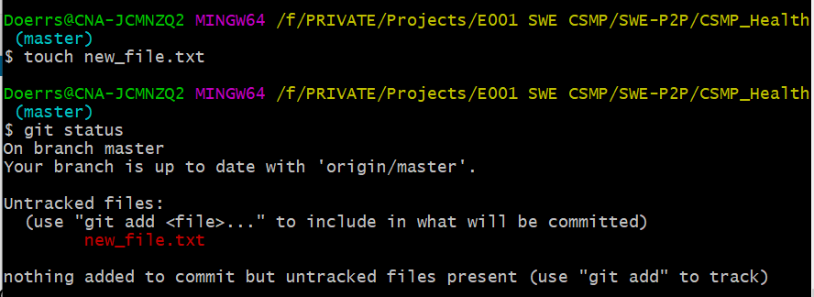
Git Commands
How do I use Git Bash?
Basic Git Workflow:
Make a change in your local repo (modify code, create a new file, etc.)
See this change tracked using git status
Git status before change: Git status after change:
MARMC
NWRMC
SERMC
SWRMC

Slide 25
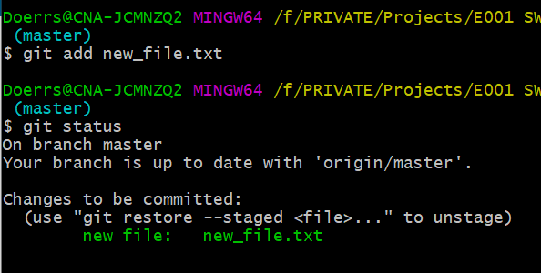

Git Commands
How do I use Git Bash?
Basic Git Workflow:
Make a change in your local repo (modify code, create a new file, etc.)
See this change tracked using git status
Add change to staging using git add “filename” (alternatively git add *)
MARMC
NWRMC
SERMC
SWRMC
git add * to add all changes to be tracked
Git status now shows new_file.txt as tracked

Slide 26

Git Commands
Basic Git Workflow:
Make a change in your local repo (modify code, create a new file, etc.)
See this change tracked using git status
Add change to staging using git add “filename” (alternatively git add *)
Commit changes to local repo using git commit –m “commit message”
MARMC
NWRMC
SERMC
SWRMC
Commit message should be present tense
Commit message resources:
https://www.freecodecamp.org/news/writing-good-commit-messages-a-practical-guide/

Slide 27
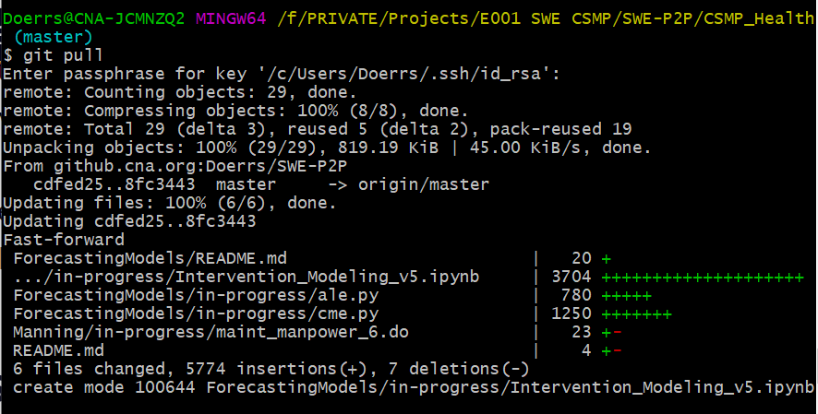
Git Commands
Basic Git Workflow:
Make a change in your local repo (modify code, create a new file, etc.)
See this change tracked using git status
Add change to staging using git add “filename” (alternatively git add *)
Commit changes to local repo using git commit –m “commit message”
Pull changes from remote repo to local repo using git pull
MARMC
NWRMC
SERMC
SWRMC
Integrating remote changes into local repo- necessary before pushing your changes

Slide 28
Git Commands
Basic Git Workflow:
Make a change in your local repo (modify code, create a new file, etc.)
See this change tracked using git status
Add change to staging using git add “filename” (alternatively git add *)
Commit changes to local repo using git commit –m “commit message”
Pull changes from remote repo to local repo using git pull
Now push your changes to remote repo using git push
MARMC
NWRMC
SERMC
SWRMC
After git push:
Git automatically fast forward merges with remote OR
You need to enter merge message to perform merge
After entering merge message type:
Esc + : + wq! + Enter
to submit and escape window

Slide 29
Git Commands
You have now learned basic workflow to use git!
Remember, four basic steps:
git add
git commit
git pull
git push
Use these to add changes to local and remote repo every week
MARMC
Will just add changes to local repo
NWRMC
Will integrate changes with remote repo (on github)
SERMC
SWRMC

Slide 30
Git Branching
What is a branch?
Divergence of current changes from Master branch
MARMC
Master Branch
Original Node
Change 1 Node

Slide 31
Git Branching
What is a branch?
Divergence of current changes from Master branch
MARMC
Master Branch
Original Node
Change 1 Node
Feature Branch
Feature 1 Node
Feature developed separately to not interfere with or break the Master branch code

Slide 32
Git Branching
What is a branch?
Divergence of current changes from Master branch
MARMC
Master Branch
Original Node
Change 1 Node
Merged Node
Feature Branch
Feature 1 Node
Feature developed separately to not interfere with or break the Master branch code

Slide 33
Branching Strategies and Standards
When is branching useful?
For new features which will break existing code, or concurrent development of same code pieces with another teammate
For concurrent development each teammate should checkout new branch
Steps for creating new branch:
Open Git Bash and navigate to repo using cd
Type: git checkout –b “new_branch_name” + Enter
After development, to merge branch into master:
Type: git checkout master + Enter
Type: git merge “new_branch_name” + Enter
MARMC
NWRMC
SERMC
SWRMC
This will merge to local, not to remote! Follow git basic workflow (slide 26) to push to remote
Notes:
To push new branch to GitHub (origin is another name for git repo? Master branch?): `git push –u origin <branch>`
To delete branch locally (after merging w/ master): `git branch –d <branch>`
To push branch deletion to GitHub: `git push –d origin <branch>`

Slide 34
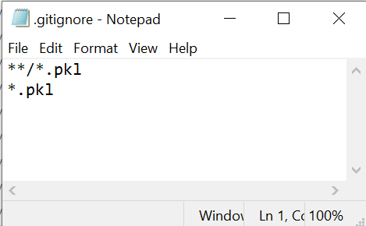
Git Ignore
Git will automatically track any files in repo by default
Recommended not to track data files or output graphs and figures
Add specific file endings or files in specific folders to .gitignore
.gitignore
MARMC
NWRMC
SERMC
SWRMC
Will ignore pickle files inside of any folder (all folders matched with **)
Will ignore all pickle files in immediate repo (*.pkl matches all files that end with .pkl)

Slide 35
Git Common Pitfalls
Forgetting to git add before committing
Nothing will happen if nothing is staged
Not configuring git ignore
Accidentally adding pictures, graphs, data, or unwanted material to tracking in local and remote repo
https://www.atlassian.com/git/tutorials/saving-changes/gitignore
Git add * including files you don’t want (or want to be committed separately)
Git reset (removes files from staging)
Waiting too long to commit (not committing one change at a time)

Slide 36
Git Common Pitfalls
Not pulling often enough
Will create divergence of your local repo from remote repo!
Poor documentation of changes
Always make a useful commit message
https://www.freecodecamp.org/news/writing-good-commit-messages-a-practical-guide/
Modifying the same files without communication (merge conflicts)
Merge conflicts require walking through code line by line using git
https://www.atlassian.com/git/tutorials/using-branches/merge-conflicts
Realizing you committed something that overwrote some code!
You can revert your commits
git log (shows history of all commits with commit hashes)
git revert [saved-hash]

Slide 37
Git Resources
What is Git: https://www.atlassian.com/git/tutorials/what-is-git
Overview of what git is, why it’s used, and its features
Step-by-step getting started: https://docs.github.com/en/github/getting-started-with-github
Useful for debugging, step-by-step instructions and brief explanations
Git documentation of commands: https://git-scm.com/docs
Useful reference if you forget a command, or its modifiers
When you get yourself in a bind: https://dangitgit.com/
MARMC
NWRMC
SERMC
SWRMC

